Slide 1


AUTONOMY AT WORK
Tainguyen~meumoc

Slide 2
AGENDA
I. WHAT IS AUTONOMY AT WORK
II. WHY IS AUTONOMY IN THE WORKPLACE IMPORTANT
III. HOW TO ENCOURAGE AUTONOMY AT WORK
IV. TOOLS AND TECHNOLOGIES FOR AUTONOMY

Slide 3

I. WHAT IS AUTONOMY AT WORK
Autonomy at work refers to the level of independence and freedom employees have in making decisions and taking ownership of their tasks.

Slide 4

II. WHY IS AUTONOMY IN THE WORKPLACE IMPORTANT

Slide 5
1
Advantages of Autonomy
2
Examples of Autonomous Work Environments
3
Disadvantages of Autonomy

Slide 6

1. Advantages of Autonomy
1
Increased Productivity
2
Enhanced Creativity
Employees are motivated and self-driven, resulting in higher output.
Space for innovative thinking and novel problem-solving approaches.
3
Improved Job Satisfaction
Empowerment fosters a sense of fulfillment.

Slide 7


2. Examples of Autonomous Work Environments
Start-up Culture
Remote Work Settings
Many start-up companies thrive in an environment that promotes autonomy, encouraging employees to take risks and think outside the box.
Remote work allows individuals to operate autonomously, managing their time and tasks without the constraints of a traditional office environment.

Slide 8

3. Disadvantages of Autonomy
Risk of Isolation
Loss of Coordination
Member feelings of isolation among team members working autonomously
Exploring challenges in coordinating efforts
→ Strategies to maintain a sense of belonging and connection.
→Solutions for effective collaboration and project management.
Accountability Issues
Addressing concerns related to accountability and responsibility

Slide 9




III. How to encourage autonomy at work
Clear Goal Setting
Establish objectives to guide independent decision making.
Structured Feedback
Regular reviews to share insights and align expectations.
Empowerment Workshops
Training to develop decision-making and problem-solving skills.

Slide 10




IV. Tools and Technologies for Autonomy
Project Management Platforms
Platforms such as Asana and Trello facilitate task management, enabling individuals to organize and prioritize their work autonomously.
Communication Tools
Instant messaging apps like Slack and Microsoft Teams support remote autonomy by fostering real-time collaboration and transparent communication.
Knowledge Sharing Systems
Knowledge and document sharing platforms like Google Drive and SharePoint empower individuals to access information independently, enabling informed decision-making.

Slide 11
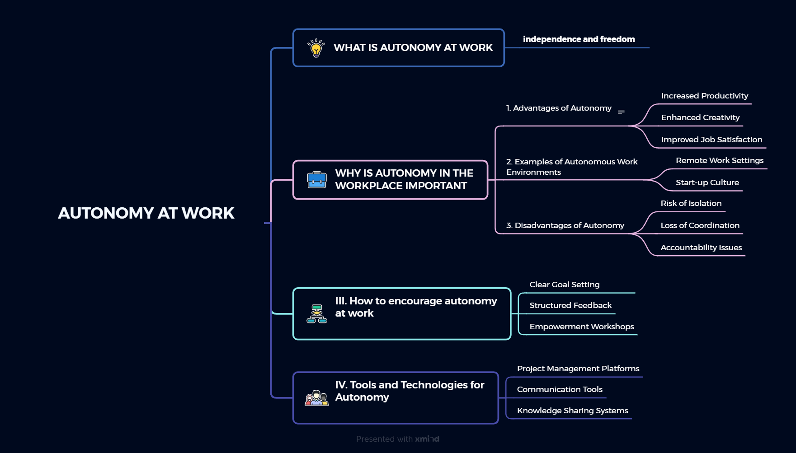

Slide 12
THANKS FOR WATCHING

